Slide 1
Opioid Crisis: HHS Strategy and Advancing Pain Management
Dr. Vanila M. Singh, MD MACM
Chief Medical Officer, OASH
U.S. Department of Health and Human Services
Chair, Pain Management Best Practices
Inter-Agency Task Force
South Carolina
House Opioid Abuse Prevention Study Committee
June 25, 2019

Slide 2
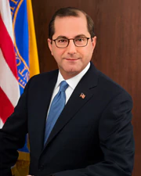
HHS Secretary Alex M. Azar II Priorities
Combating the opioid crisis
Bringing down the high price of prescription drugs
Addressing the cost and availability of health insurance
Value-based transformation of our healthcare system

Slide 3
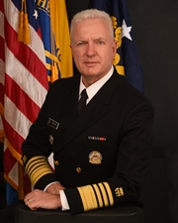
Office of the Assistant Secretary for Health
ADM Brett P. Giroir, M.D.
Assistant Secretary for Health
Senior Advisor to the HHS Secretary for Opioid Policy

Slide 4










Slide 5
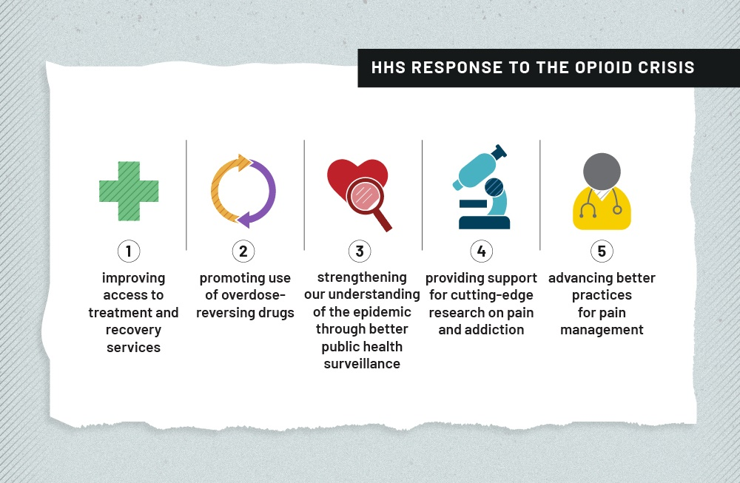

Slide 6
Rise in Prescription Opioid Deaths in United States
Natural and semi-synthetic opioid death rate increased 4-fold from 1999 to 2011
1st Wave
Over 183,000 people have died from prescription opioids since 1999
Methadone death rate increased 6-fold from 1999 to 2007
SOURCE: National Vital Statistics System Mortality File.

Slide 7
Rise in Heroin Deaths in United States
2nd Wave
Over 70,000 people have died from heroin since 2010
Heroin death rate has increased over 4 fold since 2010
SOURCE: National Vital Statistics System Mortality File.

Slide 8
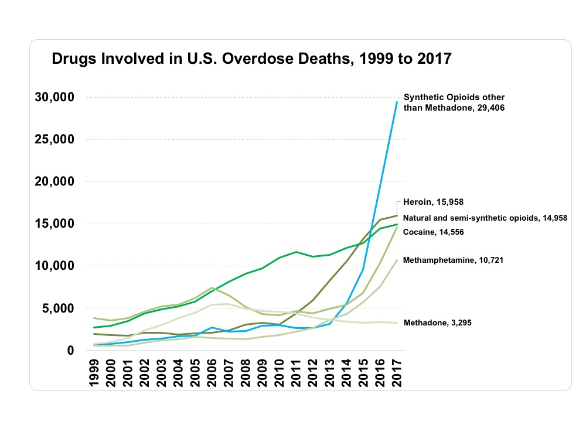
3rd Wave

Slide 9
Numbers of People Aged 12 or Older with a Past Year Substance Use Disorder: 2017
FFR1.39

Slide 10
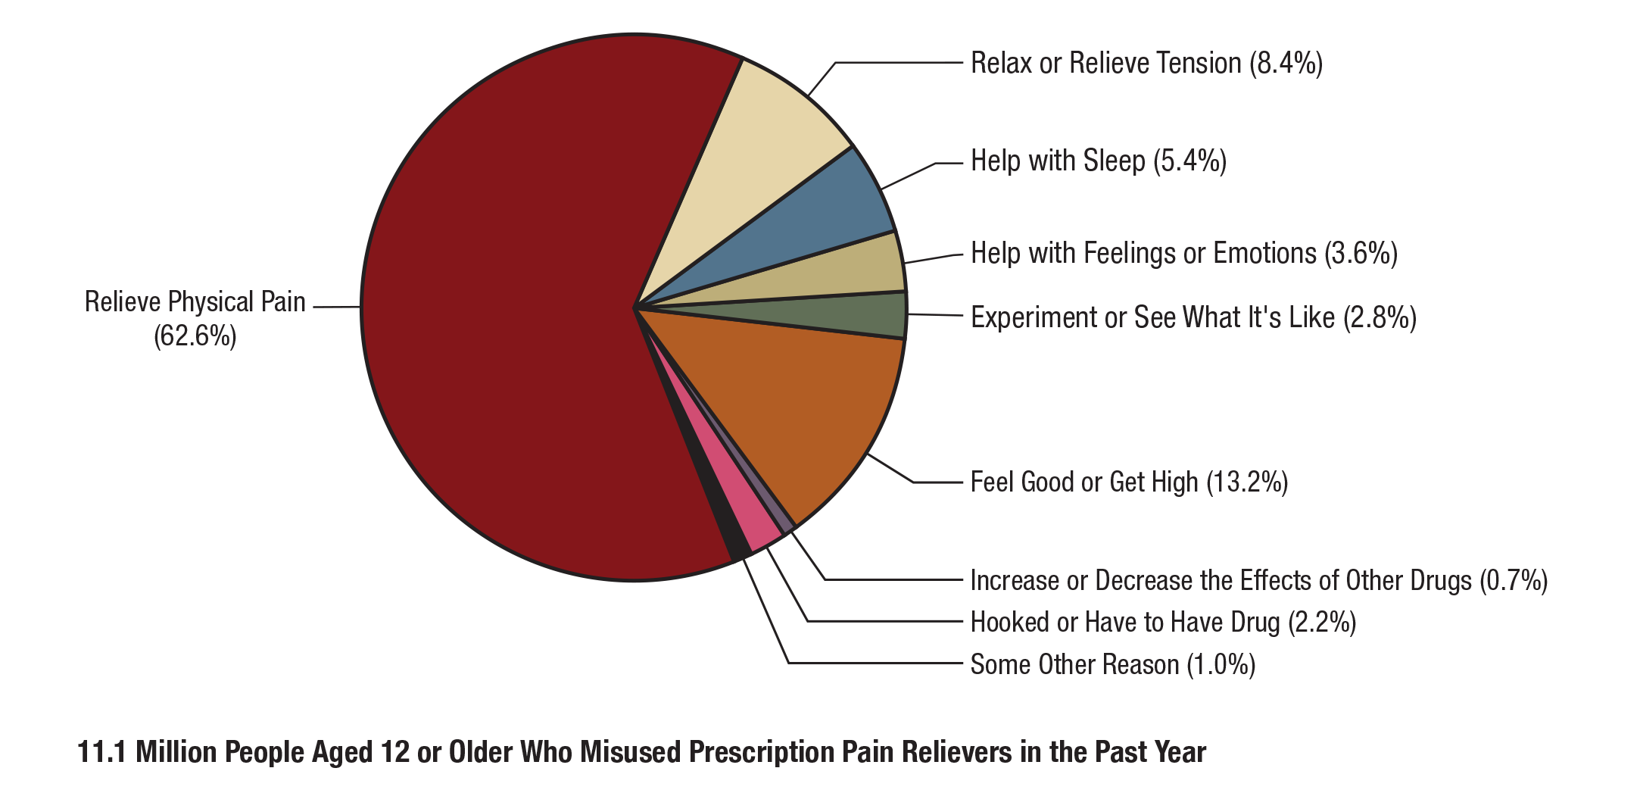

Main Reason for the Most Recent Prescription Pain Reliever Misuse among People Aged 12 or Older Who Misused Prescription Pain Relievers in the Past Year: Percentages, 2017
FFR1.25
*Misuse of prescription drugs means taking a medication in a manner or dose other than prescribed; taking someone else’s prescription, even if for a legitimate medical complaint such as pain; or taking a medication to feel euphoria (i.e., to get high).

Slide 11
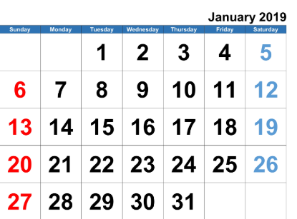

Latest: Pain in the U.S. (CDC, 2018)
50 million American adults suffer from chronic pain daily or almost daily
19.6 million American adults have high-impact chronic pain

Slide 12
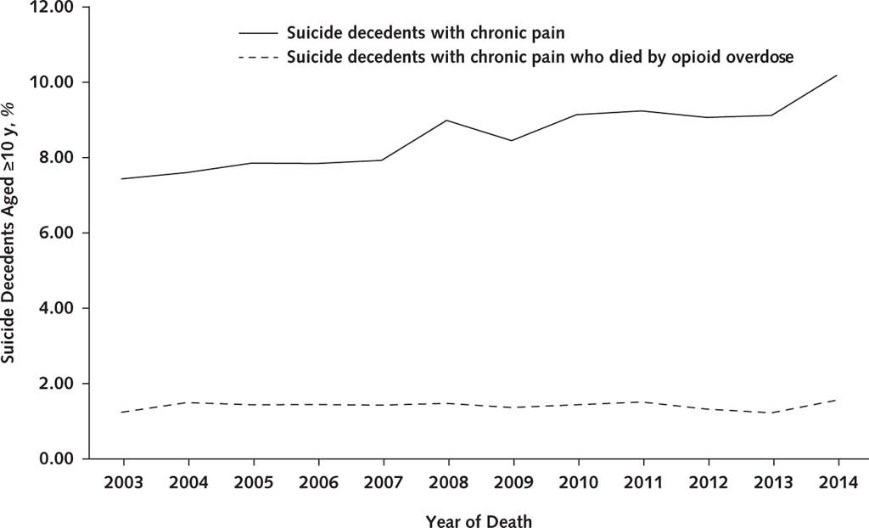
Chronic Pain Among Suicide Decedents, 2003 to 2014:
Findings From the National Violent Death Reporting System

Slide 13
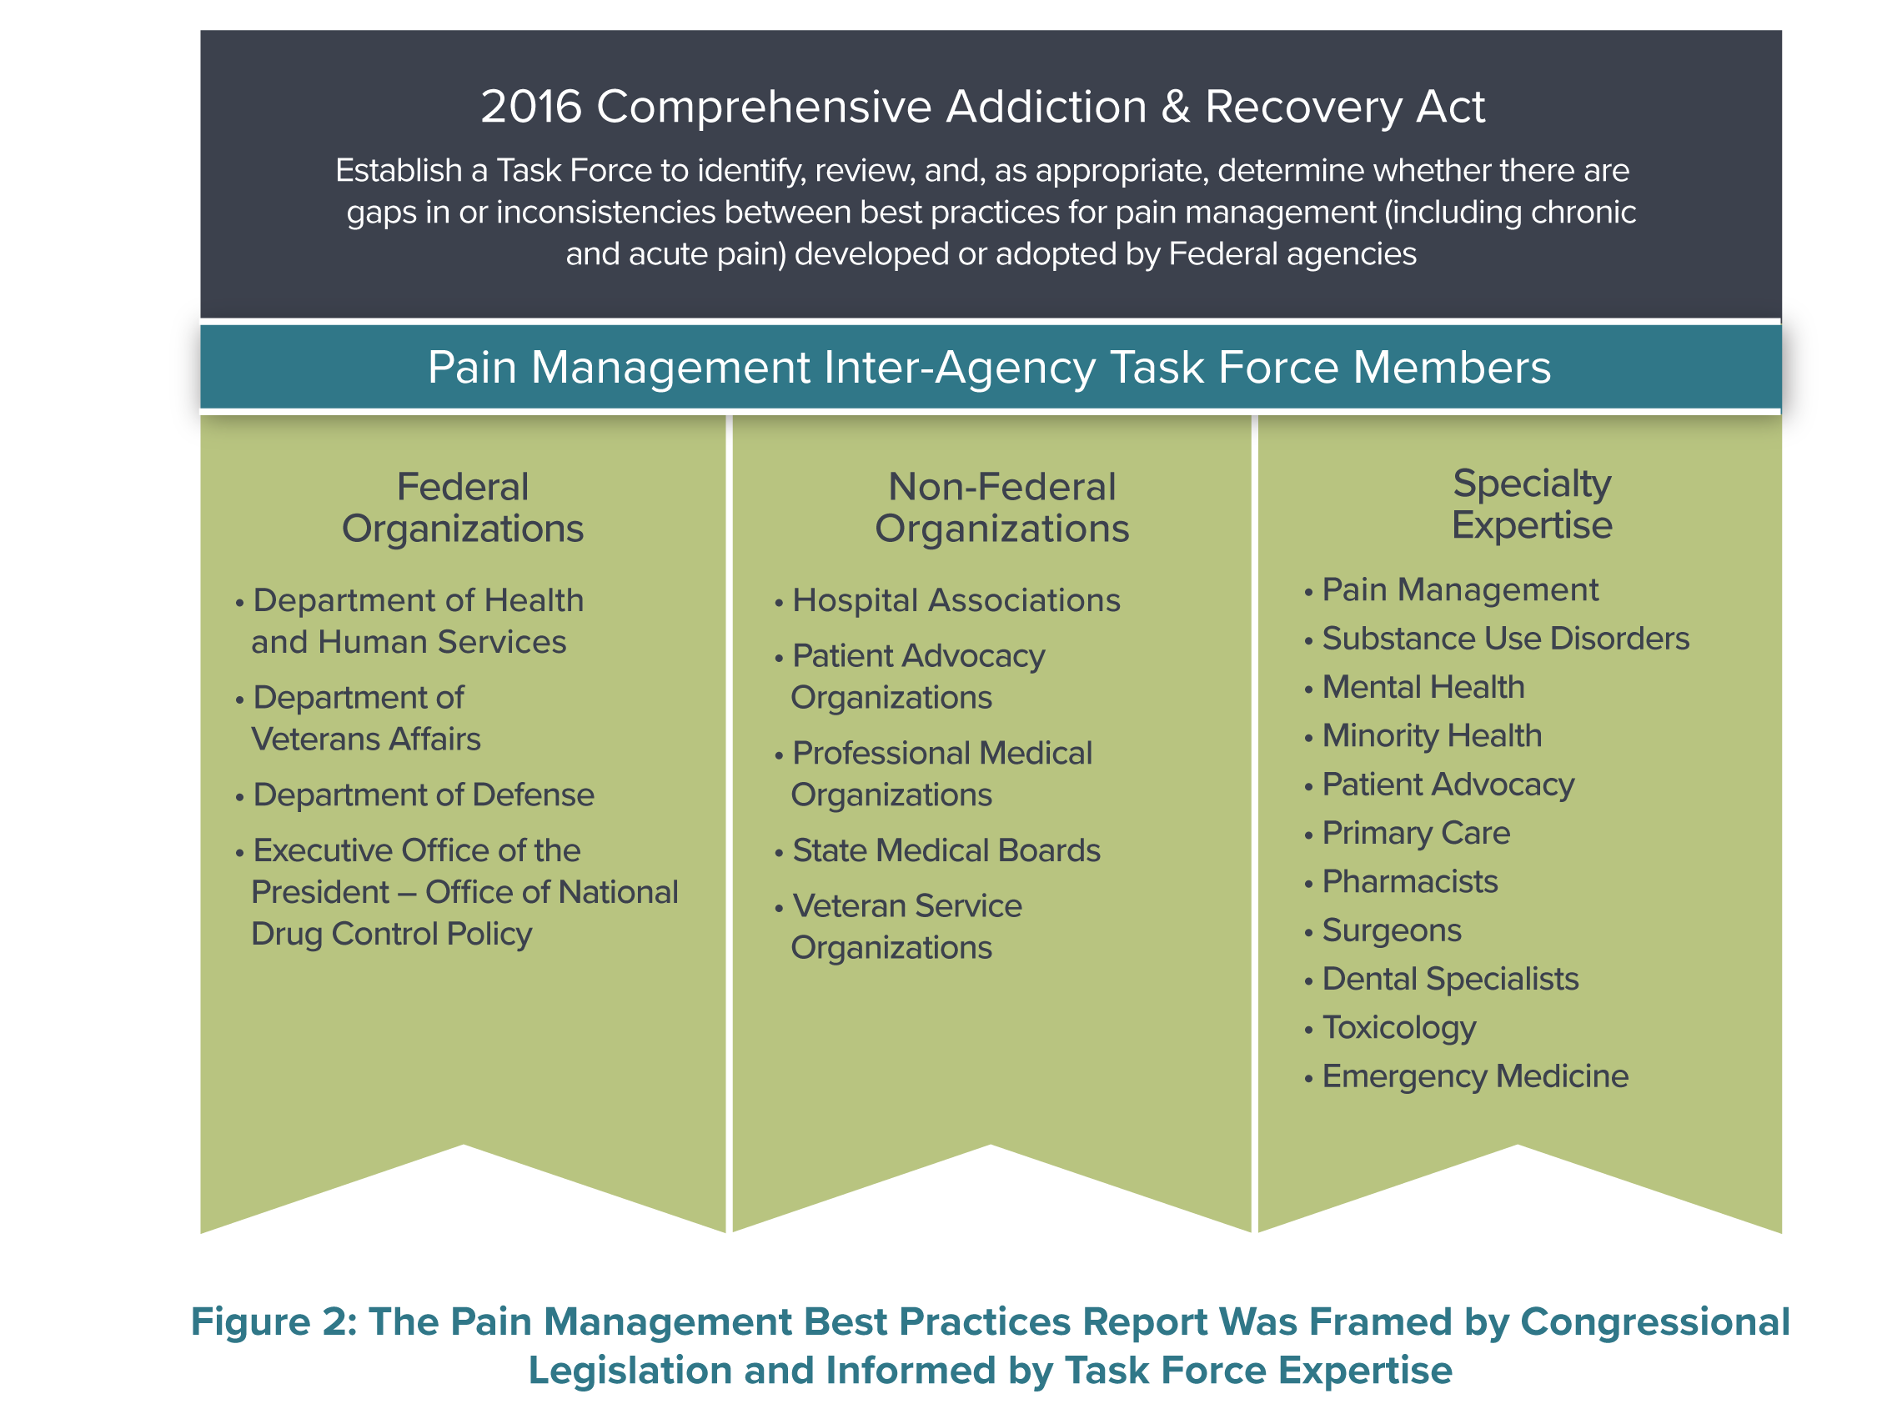
Pain Management Best Practices Inter-Agency Task Force
Gaps and Recommendations Overwhelmingly Passed
https://www.hhs.gov/ash/advisory-committees/pain/index.html

Slide 14
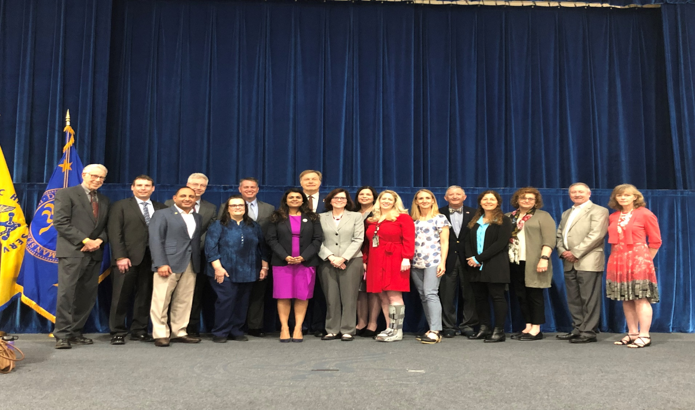
Members of the Pain Management Best Practices Inter-Agency Task Force

Slide 15
Highlights of the 150+ organizations that supported, lauded and praised the Task Force
American Medical Association
Human Rights Watch
Association of American Physicians and Surgeons
American Nurses Association
American Dental Association
American Academy of Pain Medicine
American Association of Orthopedic Surgeons
American Society of Interventional Physicians
American Society of Anesthesiologists
American Association of Nurse Anesthetists
American Academy of Hospice and Palliative Medicine
American Psychological Association
American Society of Acupuncture
National Association of Social Workers
Accreditation Council for Continuing Medical Education
American Association of Neurological Surgeons
American College of Obstetricians and Gynecologists
American College of Physicians
American College of Rheumatology
American Medical Women’s Association
American Society of Hematology
Congress of Neurological Surgeons
North American Neuromodulation Society
American Porphyria Foundation
American Board of Pain Medicine
Restless Legs Syndrome Foundation
U.S. Pain Foundation

Slide 16
Public comments to the Task Force

Slide 17

ORGANIZATIONAL COMMENTS
On behalf of the American Medical Association (AMA) and our physician and medical student members, the AMA commends the Pain Management Best Practices Task Force for its authoritative, evidence-based Draft Report. The AMA believes that if the Draft Report recommendations are implemented, it will not only improve pain care for America’s patients, but also help end the nation’s opioid epidemic. The Draft Report provides an in-depth discussion of the balance needed between medical evidence, policy, and patient compassion alongside the realities of the nation’s opioid epidemic, which continues to cause unprecedented levels of opioid-related harm. When finalized, the Draft Report and recommendations could potentially spur a shift in public policy, as well as private health insurer, pharmacy, and pharmacy benefit management (PBM) practices, to protect patients with pain from arbitrary, non-consensual tapering of opioid analgesics and denials of care, and to increase support for comprehensive, multimodal pain management practices. In each of the four main sections of the Draft Report, the AMA is supportive of nearly all of their 150+ recommendations. [...]
In sum, the AMA supports having the CDC Guideline be viewed as called for in recommendation 8a: “guidance only for a general approach, with individualized patient care as the primary goal and the clinician then considering all modalities for best outcomes.” One final comment concerns the level of scholarship in the Draft Report. The AMA commends the authors for the nearly 450 individual citations buttressing the Draft Report recommendations. This will enable the Draft Report to serve as an excellent resource for further research and objective discussion of improving pain care in the United States. Thank you for the opportunity to provide comments on this excellent report.
American Medical Association (AMA)

Slide 18
ORGANIZATIONAL COMMENTS
We strongly support the draft report’s conclusion that “individualized, patient-centered care is vital to addressing the public health pain crisis.” Sacrificing the needs of individual patients to “population health” is perhaps one of the most under-appreciated factors precipitating the current crisis. Restoring the primacy of individual patient’s interests is key to solving the issues the task force is addressing. The Association of American Physicians and Surgeons (AAPS) thanks the members for recognizing this crucial point. [...] We would like to reiterate our support for the report's emphasis that the needs of individual patients need to remain at the center of patient care decisions and that actions by third parties interfering in the patient-physician relationship need to be minimized and even eliminated. We are grateful to Dr. Singh and the task force for taking on this challenging work. Please do not hesitate to reach out to us for further discussion.
Association of American Physicians and Surgeons (AAPS)
We commend the Task Force for this timely and comprehensive report on the gaps and inconsistencies in acute and chronic pain management.
We are particularly glad that the document addresses recent developments, particularly regarding the stigmatization and mistreatment of chronic pain patients on opioid medications. We also commend the Task Force for comprehensively addressing broader issues in chronic pain care, such as the lack of condition-specific treatment algorithms, inconsistent access to care, and inadequate insurance coverage.
Human Rights Watch

Slide 19
Pain Management Task Force overview

Slide 20
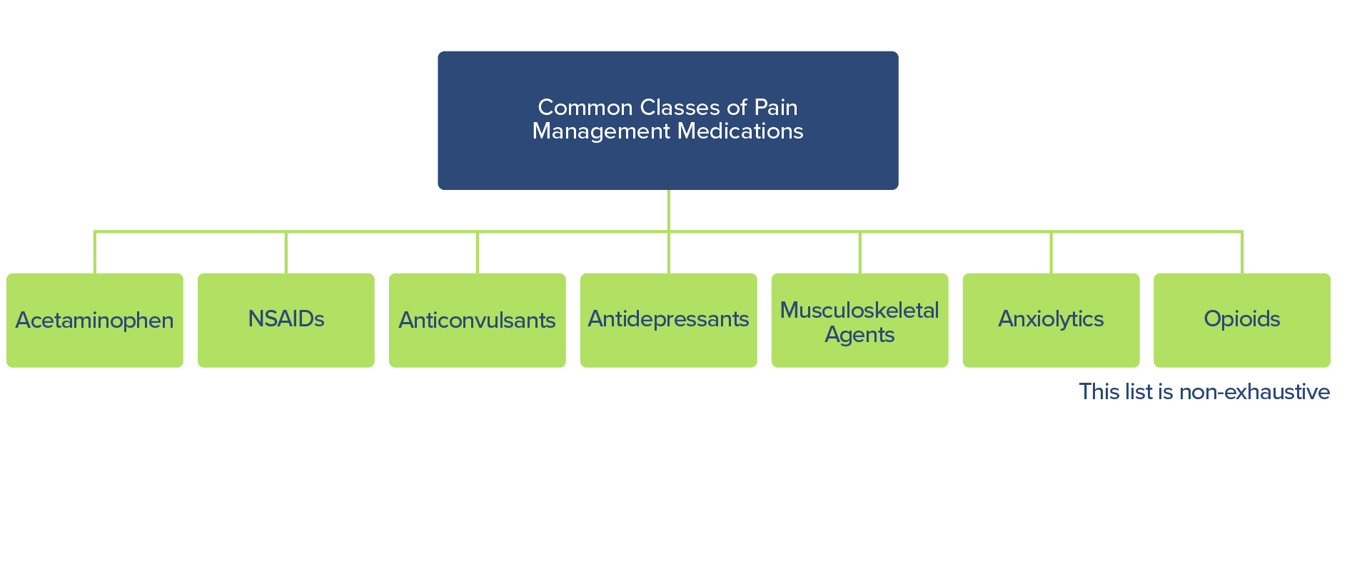
Medication Approaches to Pain Include
Opioid and Non-opioid Options

Slide 21
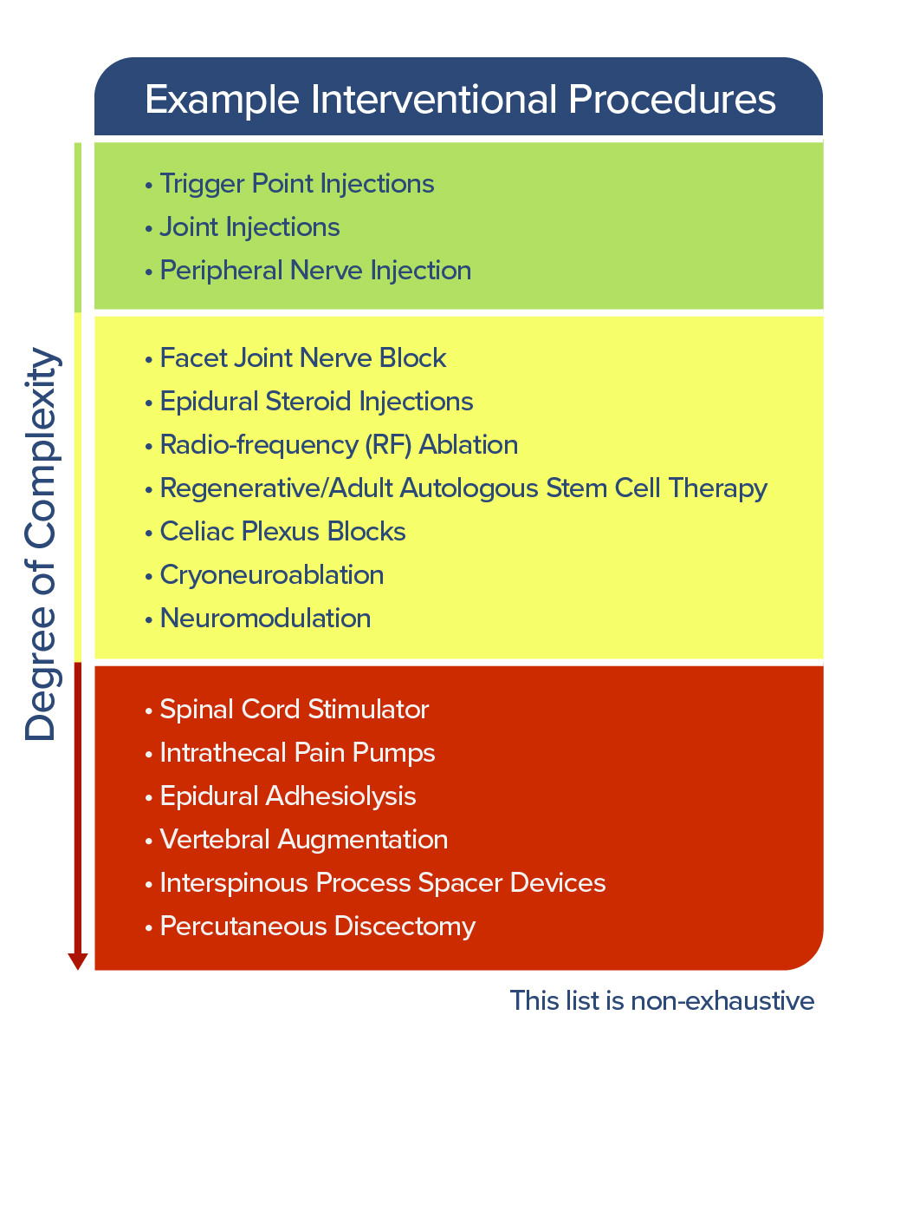
Interventional Procedures Vary by
Degree of Complexity and Invasiveness

Slide 22
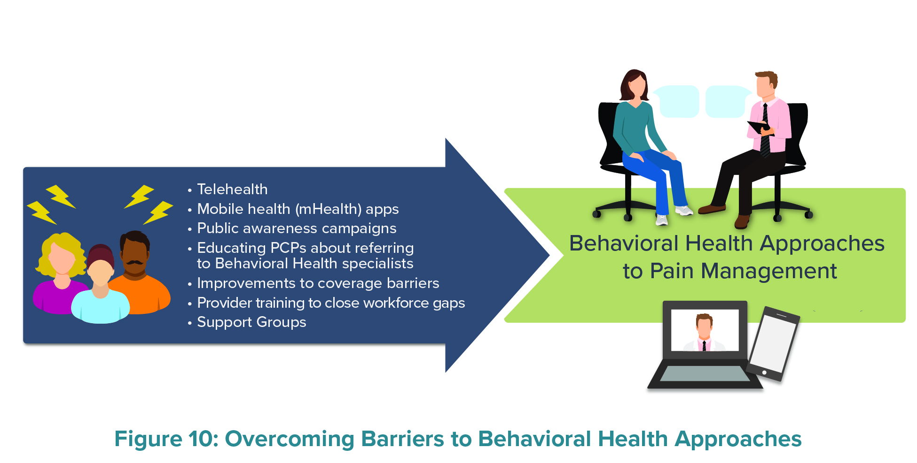
Overcoming Barriers to Behavioral Health Approaches

Slide 23
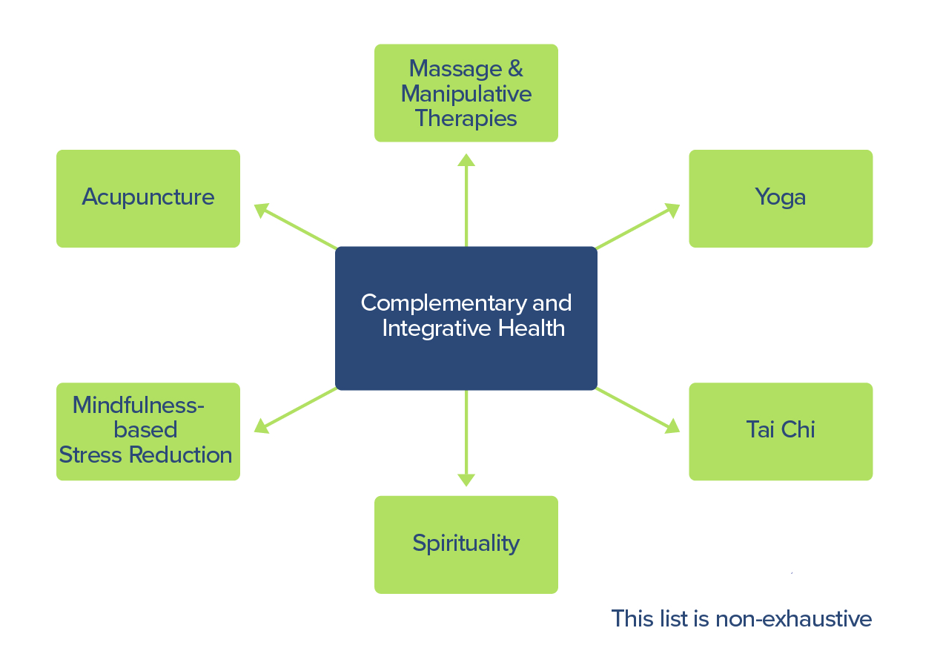
Complementary and Integrative Health Approaches

Slide 24
Pain Management Best Practices Inter-Agency Task Force
Broad overview (continued)
Innovative solutions to pain management such as telemedicine, tele-mentoring, mobile apps
Research is required to develop a better understanding of the mechanisms of pain, preventive measures, the use of innovative medical devices and medications
Special populations are highlighted, including pediatric, women, older adults, American Indians/Alaskan Natives, active duty soldiers/veterans, sickle cell disease (as an example of a chronic relapsing condition).

Slide 25
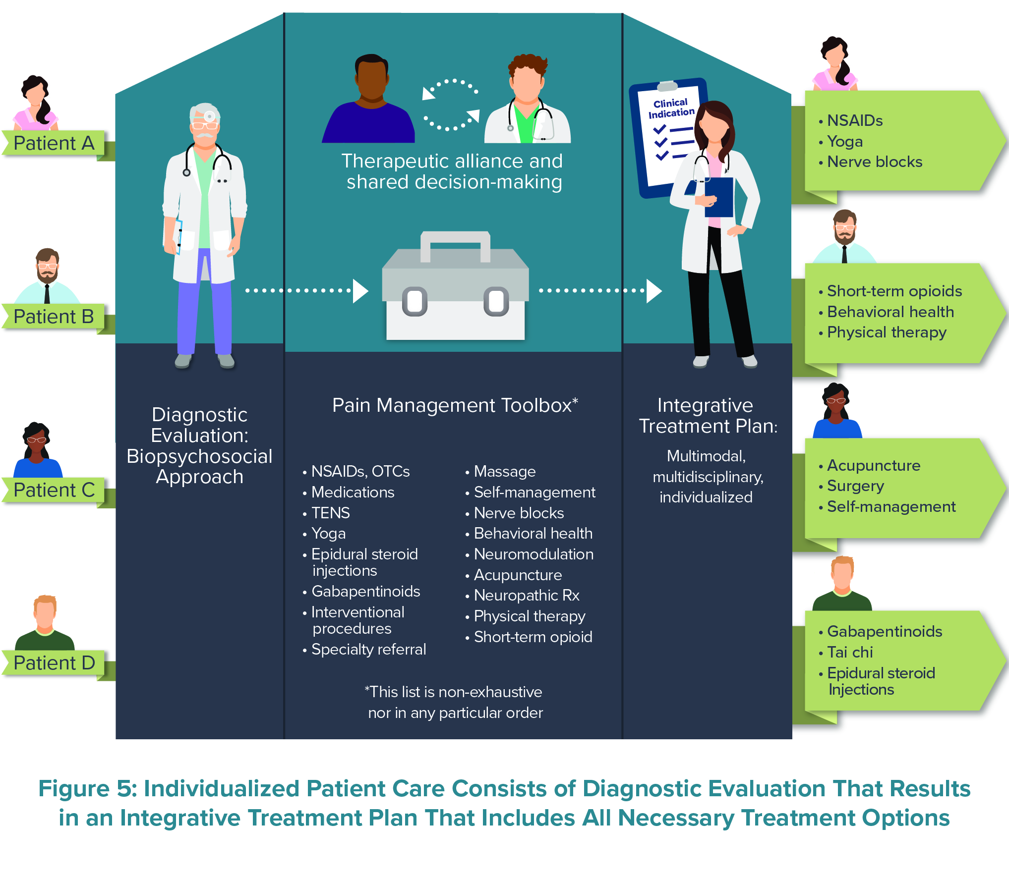
Individualized Patient Care:
Diagnostic Evaluation
Multidisciplinary (as indicated) Treatment Plan

Slide 26
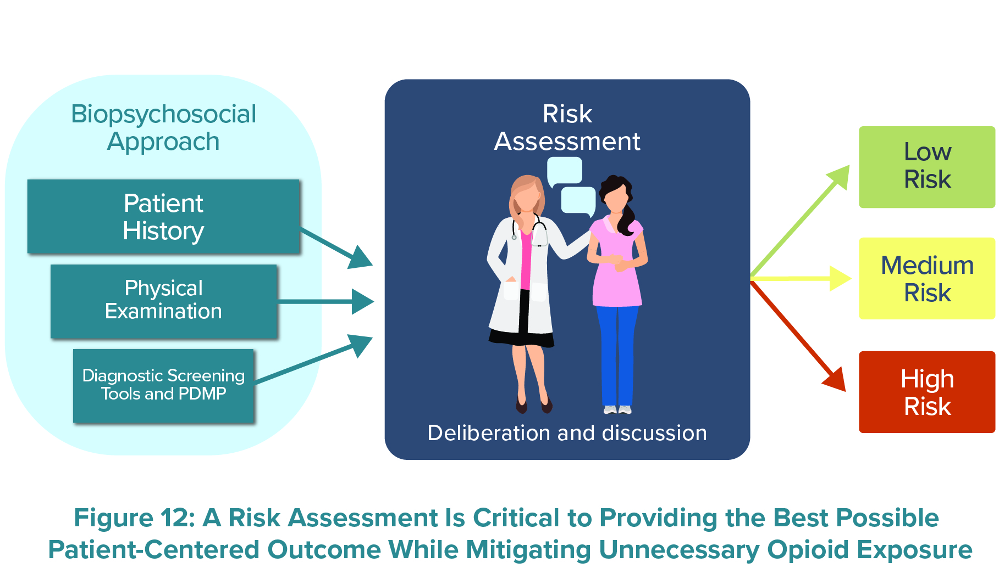
Risk Assessment for Risk-Benefit Analysis

Slide 27
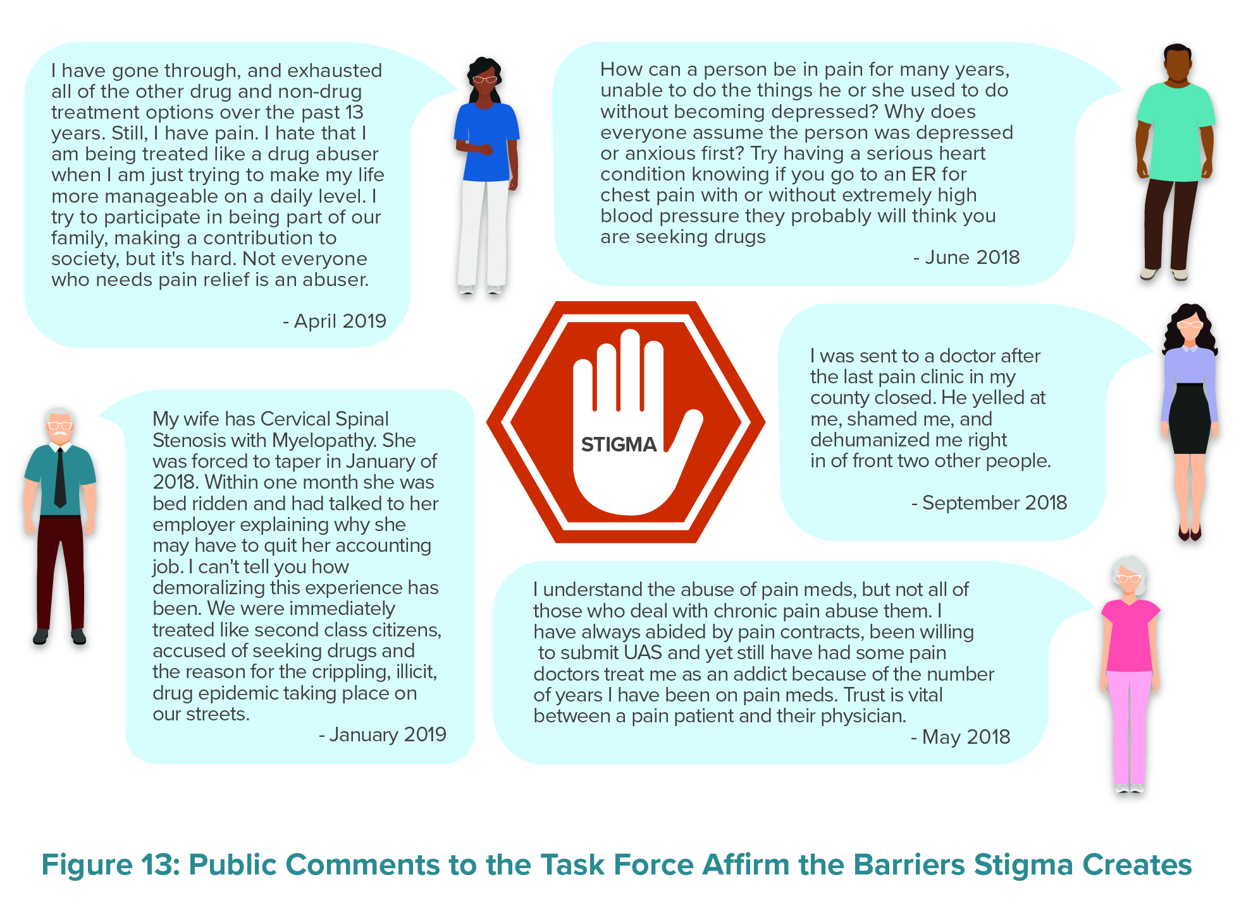
Public Comments to the Task Force Affirm the Barriers Stigma Creates

Slide 28
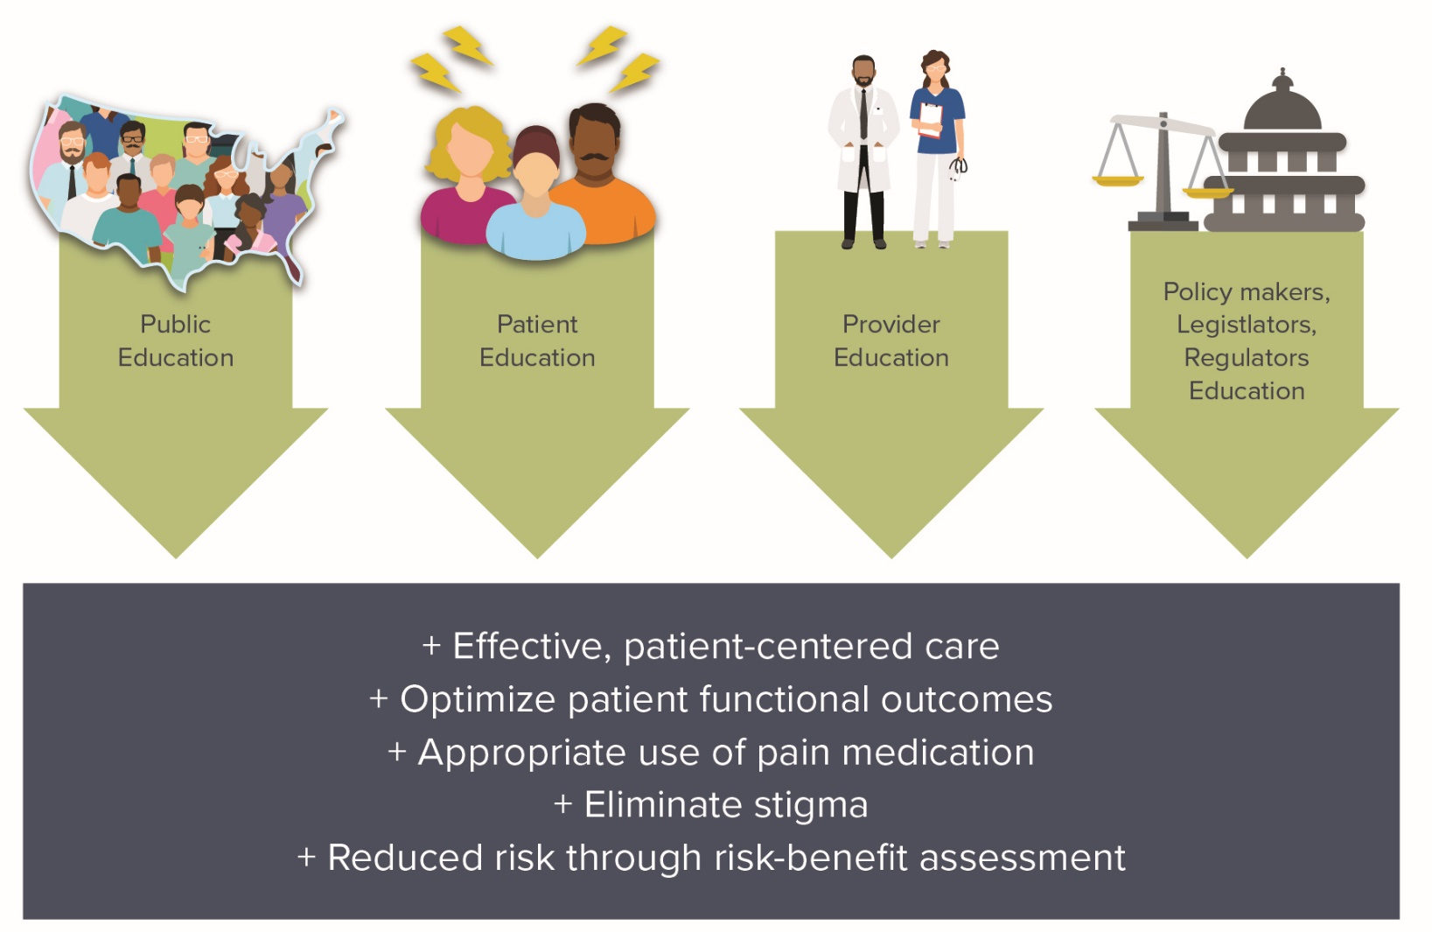
Education Is Critical to the Delivery of Effective
Patient-Centered Pain Care and
Reducing the Risk Associated With Prescription Opioids

Slide 29
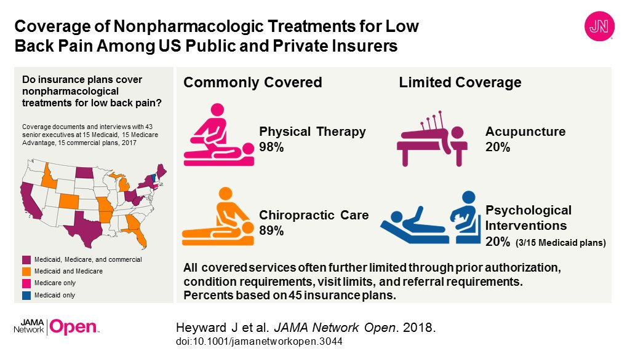
Access to care:
Improved Insurance Coverage and Payment
Barriers
Covered services further limited through prior authorization, condition requirements, visit limits and referral requirements
Non-pharmacological treatments for pain –
  Commonly covered – e.g. PT/OT
  Limited coverage – e.g. acupuncture, behavioral health interventions
Insurance Coverage for Complex Pain Management Situations
Needs
More time and resources for assessment and multimodal treatment plan
Align payer guidelines with current clinical guidelines, including non-opioid pharmacologic therapies
Complex management of pain code

Slide 30
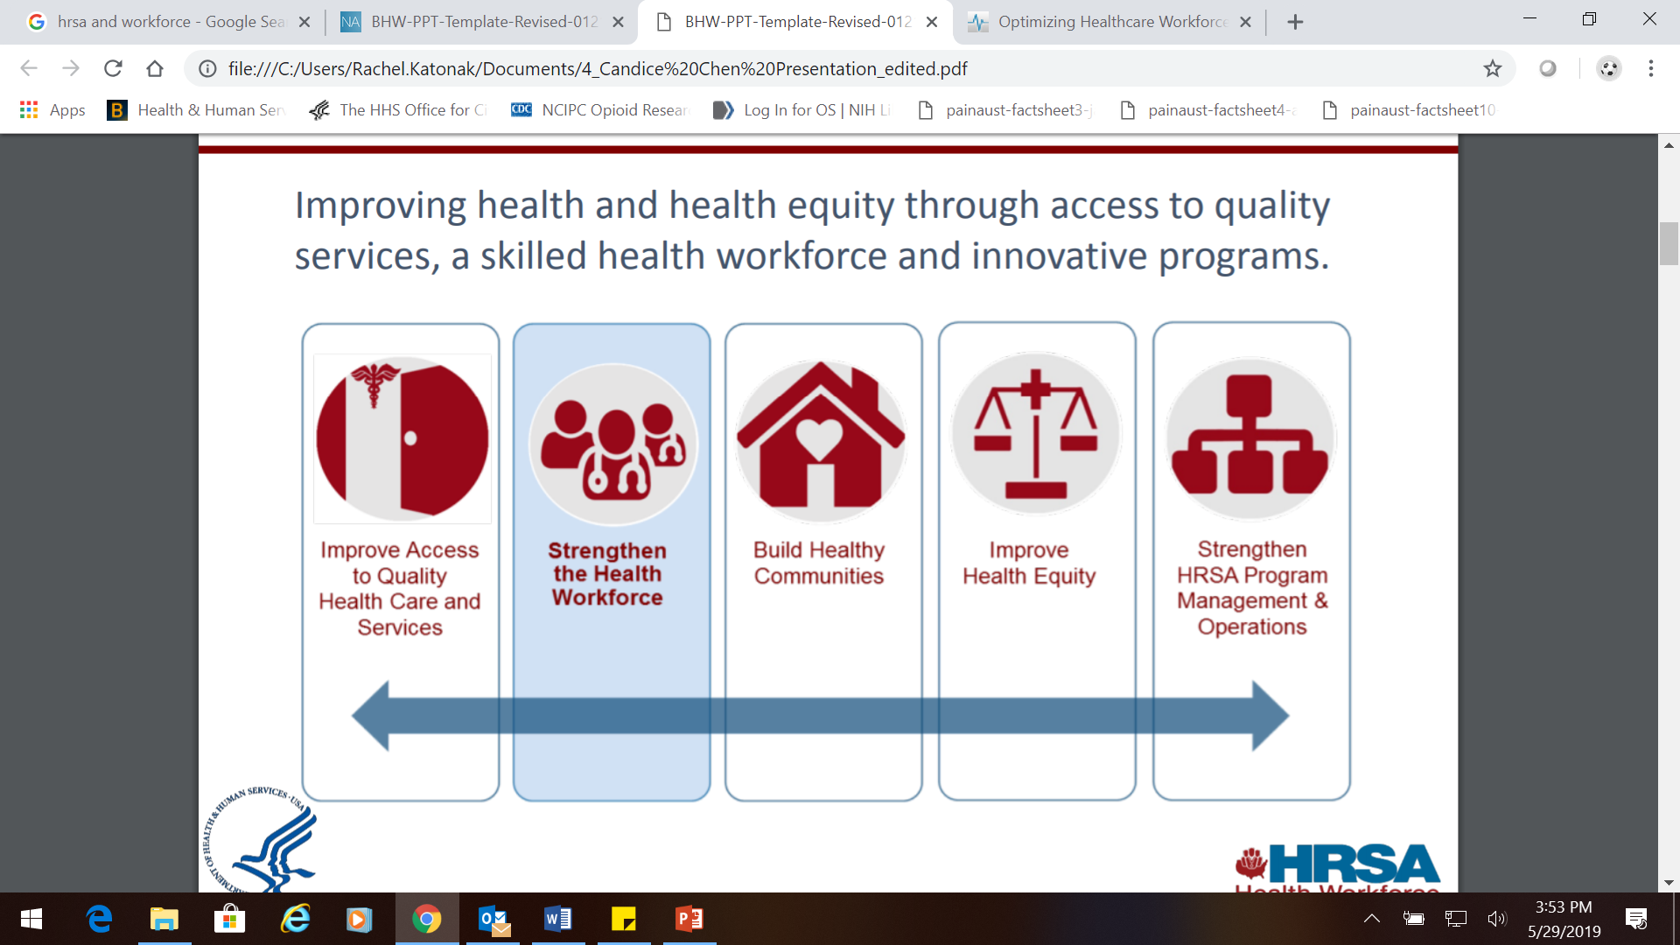
Access to care:
Workforce
Shortage of clinicians who specialize in pain and multidisciplinary pain management teams
Recommendation: Expand clinician training, professional school curricula, postgraduate training programs, and continuing education courses.
Recommendation: Expand the availability of clinician specialists
Recommendation: Encourage and incentivize the creation of multidisciplinary pain management teams and programs as centers of excellence

Slide 31
Concerns about Forced Tapers and Patient Abandonment due to misapplication and misinterpretation
FDA Safety Announcement, April 9, 2019
  FDA identifies harm reported from sudden discontinuation of opioid pain medicines and requires label changes to guide prescribers on gradual, individualized tapering
  (https://www.fda.gov/drugs/drug-safety-and-availability/fda-identifies-harm-reported-sudden-discontinuation-opioid-pain-medicines-and-requires-label-changes)
CDC NEJM Perspective, April 24, 2019
  No Shortcuts to Safer Opioid Prescribing
  (https://www.nejm.org/doi/full/10.1056/NEJMp1904190)

Slide 32
Goal: “Strike a Balance” and address both public health crisis
Important to balance the need to end the devastating effects of opioid misuse while also ensuring that pain patients can work with their doctors to develop an integrative pain treatment plan that optimizes function, quality of life, and productivity.
End opioid misuse
Treat chronic pain

Slide 33




Reach Out

Slide 34

Thank You
Dr. Vanila M. Singh, MD MACM
Chief Medical Officer
Chair, Pain Management Best Practices Inter-Agency
Task Force
Office of the Assistant Secretary for Health
U.S. Department of Health and Human Services
Email: Vanila.Singh@hhs.gov
Twitter: @cmoHHS

